Slide 1
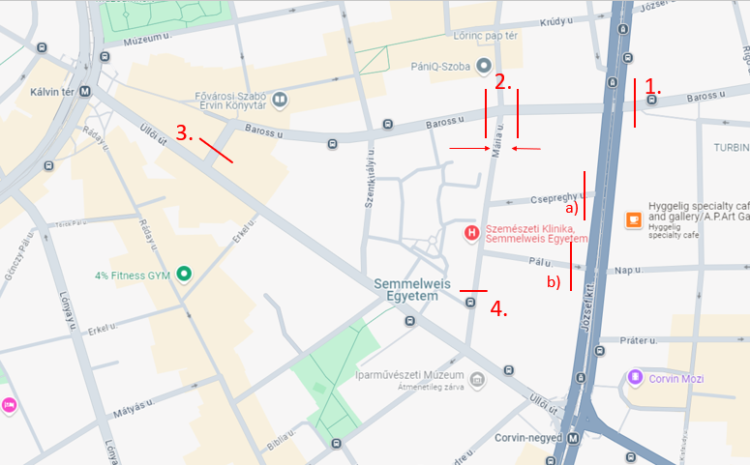
Hourly data [hour/vehicle]:
3:
From elsewhere: 76
Exp. Szentkirályi, Mária
4:
From elsewhere: 267
Exp. Csepreghy, Mária, Szentkirályi
Other:
71 vehicle: parking/ leave on Pál street
*: total values do not include these.
 | 1 | 2 | 3 | 4
Sum cars. | 373 | 405 | 259 | 436
Motorbike | 8 | 11 | 12 | 16
Bicicle* | 35 | 20 | 15 | 9
Bus* | 7 | 7 | 8 | 3
Trolley* | 13 | 12 | 9 | 3
43
5
41
142
53
109

